Slide 1
The Bible

Slide 2
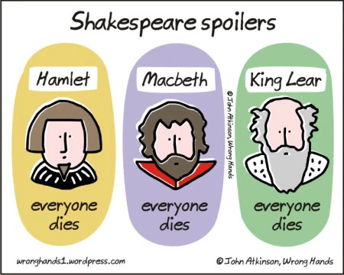

Slide 4
God is making a People and a Place for His Presence…
ACT 1 – CREATION and FALL
Genesis Part 1
ACT 2 – ISRAEL and EXILE
Genesis Part 2 – Malachi!
ACT 3 – JESUS!
Matthew, Mark, Luke & John
ACT 4 – The CHURCH
Acts – Jude (& a bit of Revelation!)
ACT 5 – NEW CREATION
Revelation….Jesus and Paul

Slide 5
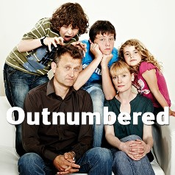
Improvise through Worship: how do we serve this God now?
Job and Psalms:
celebration, pain, and a lack of explanation

Slide 6
God is making a People and a Place for His Presence…
ACT 1 – CREATION and FALL
Genesis Part 1
COVENANT:
God always takes the initiative

Slide 7
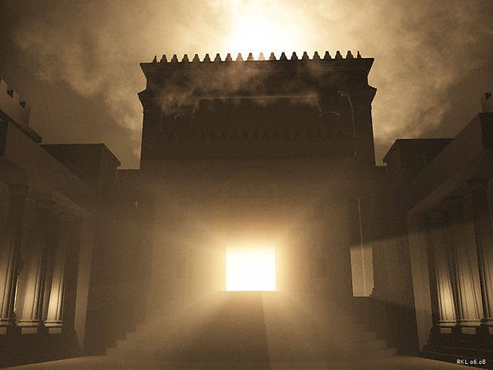
God is making a People and a Place for His Presence…
ACT 2 – ISRAEL and EXILE
Genesis Part 2 – Malachi!
God turns our rejection to good.
Israel, Temple, Law

Slide 8
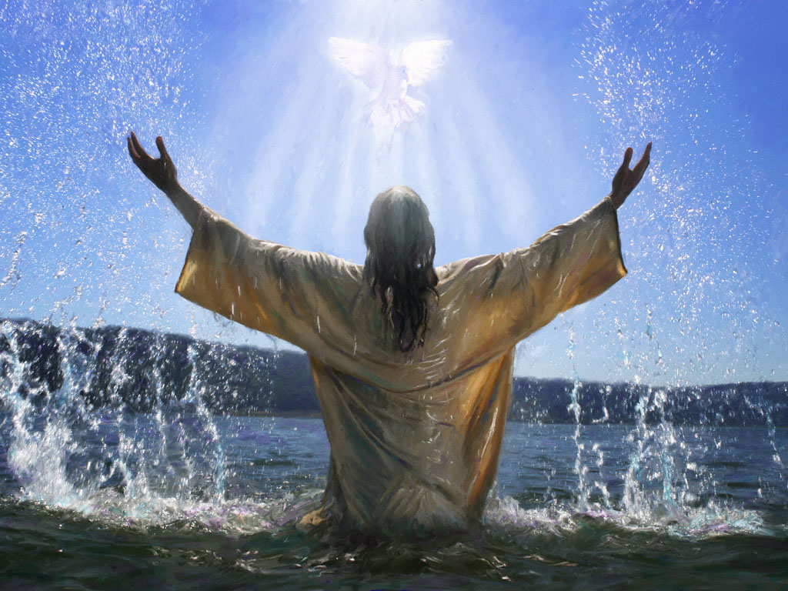
God is making a People and a Place for His Presence…
ACT 3 – JESUS!
Matthew, Mark, Luke & John
God becomes the person and the place for His presence

Slide 9
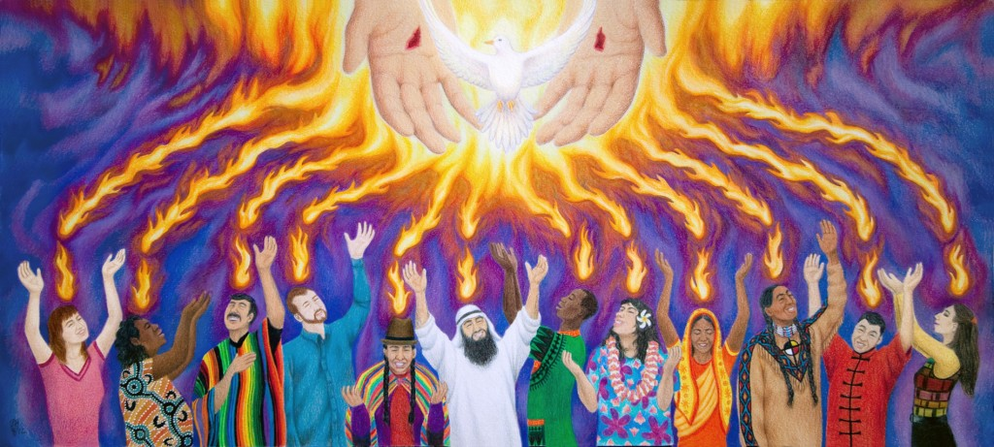
God is making a People and a Place for His Presence…
ACT 4 – The CHURCH
Acts – Jude (& a bit of Revelation!)
Body of Christ, Temple of the Spirit….a story UNFNISHED

Slide 10
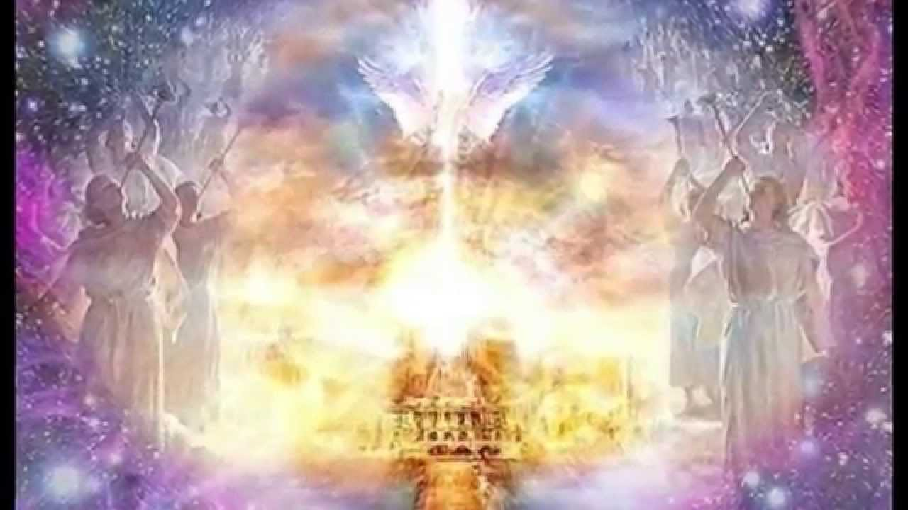
“Behold, I am making all things new…”
ACT 5 – NEW CREATION
Revelation….Jesus and Paul

